Slide 1
HTML – LINKS, LIST & TABLE

Slide 2
LINK
The syntax of creating an anchor:
<a href="url">Text to be displayed</a>
The <a> tag is used to create an anchor to link from, the href attribute is used to address the document to link to, and the words between the open and close of the anchor tag will be displayed as a hyperlink.
This anchor defines a link to a website:
<a href=“http://www.google.com”>Visit Google</a>
These anchors defines a link to a document
<a href=“hello.html”>hello.html file</a>
<a href= “http://www.w3schools.com/html/html_links.asp”>Learn HTML Link</a>

Slide 3
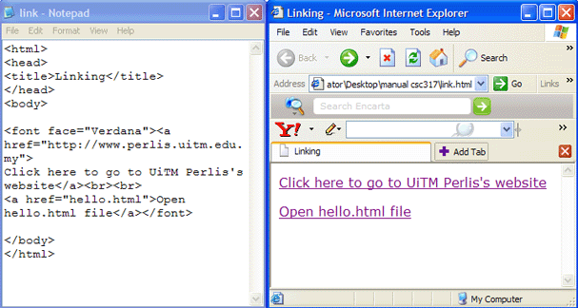
LINK

Slide 4
LINK
Using Image as anchor:
Instead of writing the label of the link, sometimes you might want to use an image to link to other pages. Here is the example:
<a href="http://www.myblog.com/"><img src ="blogpic.jpg" alt = "Click to go to my blog"></a>

Slide 5
LINK
The Target Attribute
With the target attribute, you can define where the linked document will be opened.
The line below will open the document in a new browser window or in a new tab (for browsers with tabbed browsing):
<a href="http://www.google.com/" target="_blank">Visit Google</a>

Slide 6
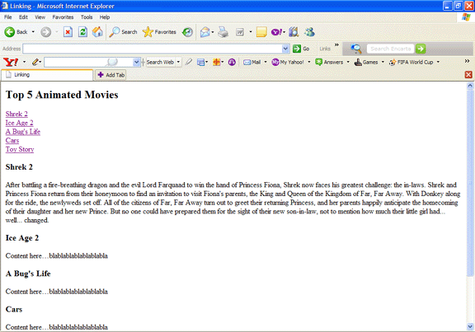
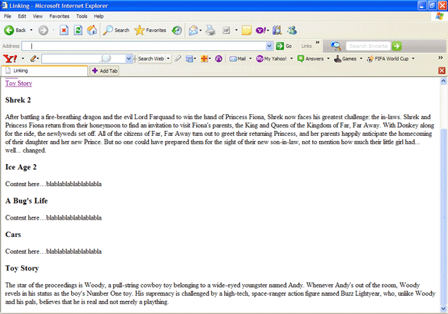
LINKING IN A LONG PAGE
<a href=#Section1>Shrek 2</a>
<a href=#Section2>Ice Age 2</a>
<a name=Section1>Shrek 2</a> <h3>Shrek 2</h3>
With anchor, you can simply click on the title to see the contents. For example, there is no need to scroll down the page to see the synopsis of Toy Story. You can click on the Toy Story title. The result is shown in the next screen shot.
This paragraph will be shown after the anchor corresponding to it is clicked.

Slide 7
LINKING IN A LONG PAGE
<html>
<head><title></title>
</head>
<body>
<a href=#Sectionname>Display title here</a>
<a name=Sectionname>Write all contents here</a>
</body>
</html>

Slide 8
LIST
There are two types of list tag namely:
  Unordered list
  Ordered list
Unordered list has the following format:
<ul>
<li> text </li>
<li> text </li>
</ul>
Other methods: Output:
<ul type= “disc”> •
<ul type= “square”> ▪
<ul type= “circle”> o

Slide 9
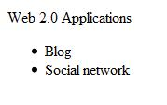
UNORDERED LIST
Web 2.0 Applications <ul> <li> Blog</li> <li> Social network </li> </ul>

Slide 10
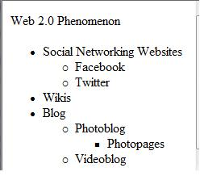
CASCADED UNORDERED LIST
Web 2.0 Phenomenon <ul> <li> Social Networking Websites </li> <ul> <li> Facebook </li> <li> Twitter </li> </ul> <li> Wikis </li> <li> Blog </li> <ul> <li> Photoblog</li> <ul> <li>Photopages</li></ul> <li> Videoblog </li> </ul> </ul>

Slide 11
ORDERED LIST
  <ol>
  <li> text </li>
  <li> text </li>
  </ol>
Other methods:
  <ol type= “A”>
  <ol type= “a”>
  <ol type= “I”>
  <ol type= “i”>

Slide 12
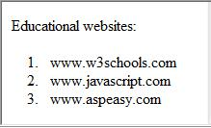
<OL>
Educational websites: <ol> <li> www.w3schools.com </li> <li> www.javascript.com </li> <li> www.aspeasy.com</li> </ol>

Slide 13
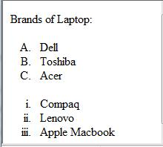
<OL>
Brands of Laptop: <ol type="A"> <li> Dell </li> <li> Toshiba </li> <li> Acer </li> </ol> <ol type="i"> <li> Compaq </li> <li> Lenovo </li> <li> Apple Macbook </li> </ol>

Slide 14
TABLE
<TABLE>
<TR><TD>Text </TD></TR>
</TABLE>
<TR>..</TR> tag refers to table row.
<TD>..</TD> refers to table data. A data cell can contain text, images, lists, paragraphs, forms, horizontal rules, tables, etc.

Slide 15

TABLE
<TABLE border=“1”>
<TR>
<TD>Row 1,Column 1</TD><TD>Row 1, Column 2</TD>
</TR>
<TR>
<TD>Row 2, Column 1</TD><TD>Row 2, Column 2</TD>
</TR>
</TABLE>

Slide 16
Attributes | Function | Possible value
Border | Width in pixel | Border = “2”
Cellspacing | Space between the cells in the table | Cellspacing = 2
Cellpadding | Space between edges of the cell and its content | Cellpadding = 10
Bgcolor | To set the background color | Eg: <table border =“1” bgcolor= “yellow”>
Background | To set the background image | Eg: <table background= “myimage.jpg”>

Slide 17
<TR> … </TR>
Attributes | Function | Possible value
Align | Horizontal alignment | left, right, center
Valign | Vertical alignment | top, middle, bottom
Bgcolor | To set the background color
Background | To set the background image

Slide 18
<TD> … </TD>
Attributes | Function | Possible value
Align | Horizontal alignment | Left, right, center
Valign | Vertical alignment | Top, middle, bottom
Width | Width of the column | Eg: width= “50”
Rowspan | No.of rows this cell will span | Eg: rowspan= “2”
Colspan | No.of columns this cell will span | Eg: colspan= “3”
Bgcolor | To set the background color
Background | To set the background image

Slide 19

HEADINGS
<table border="1">< tr><th>Heading 1</th><th>Heading 2</th></tr> <tr><td>row 1, column 1</td> <td>row 1, column 2</td></tr> <tr><td>row 2, column 1</td><td>row 2, column 2</td></tr> </table>

Slide 20

TABLE WITH COLSPAN
<table border=1> <tr> <td colspan=2>Aspire</td> </tr> <tr> <td>Brilliant</td><td>Courage</td> </tr> </table>

Slide 21

TABLE WITH ROWSPAN
<html> <head></head> <body> <table border=1> <tr> <td>Dare</td><td rowspan=2>Enthusiastic</td> </tr> <tr> <td rowspan = 2>Fantastic</td> </tr> </table> </body> </html>

Slide 22

TABLE WITH COLSPAN,ROWSPAN
<html> <head></head> <body> <table border=1> <tr> <td colspan=2 align=center>Hardworking</td> </tr> <tr> <td rowspan = 2 valign=bottom>Knowledge</td> <td>Independent</td> </tr> <tr> <td>Determination</td></tr> </table></body> </html>

Slide 23
HTML - FORM

Slide 24

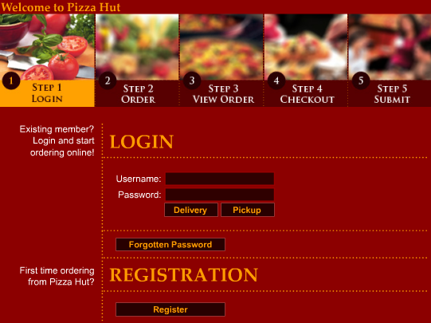
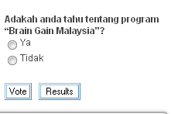
Form in Websites

Slide 25
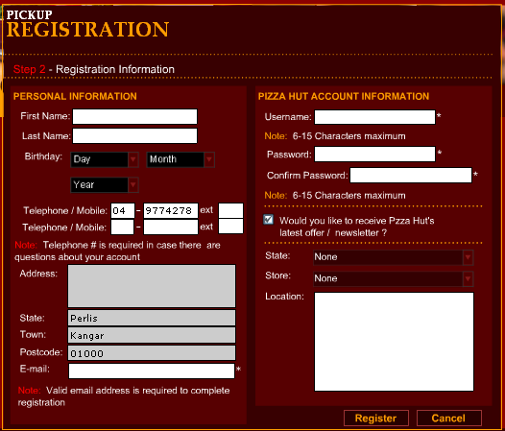
Form in Websites

Slide 26
Form
Form allows a website to receive feedback, orders or other information from the user to be further processed by client-side or server-side processing. Examples of forms are the guestbook, registration form and order form.
Form elements are elements that allow the user to enter information (like text fields, textarea fields, drop-down menus, radio buttons, checkboxes, etc.) in a form.
A form is defined with the <form> tag.
  <form>
  <input>
  </input>
  </form>

Slide 27
Form Attributes
Attribute | Description
name | Name of the form
method | Define the way data will be transferred. Values accepted are GET and POST.
action | The address or page of which data will be sent and processed.
<form name= “register” method= “POST” action= “formprocess.asp”>
….
</form>
The above example creates a form section with the name register. Data will be sent using Post method to formprocess.asp

Slide 28

Form
POST method will send data through ‘document’ which is hidden from the user.
GET method will attach the data given by the user to the destination URL.

Slide 29
Form Elements
Method | Tag
Textbox | <input type= "text">
Radio Button | <input type= "radio">
Check Box | <input type= "checkbox">
Hidden | <input type= "hidden">
Text area | <textarea>..</textarea>
List down box | <select>..</select>
Password | <input type= "password"> When any text is written in this type of input box, ‘*’ will appear.

Slide 30
Textbox, Radio Button, Check Box
Property | Description
type | Define the type of Input. Acceptable values include text, hidden, radio, reset or submit.
name | Name of the input.
value | Default value if the user did not enter any.
checked | For checkboxes and radio button. To indicate whether item is checked by default.
disabled | The item cannot be changed. Not submitted with other data.
readonly | The item cannot be changed. Submitted with other data.

Slide 31

Multiline Text
Attribute | Description
name | Name of tag.
rows | Size of Rows.
cols | Size of Columns.
disabled | Cannot be changed and not submitted as data.
readonly | Cannot be changed but submitted as data.
wrap | Indicate whether data will be wrapped to the next line.
<textarea name=“comment” rows=“4” cols=“40”>
</textarea>

Slide 32

Multiline Text
If you need to write a label inside the textarea, you can do it like this:
Comment: <br><textarea name=“comment” rows=“4” cols=“40”>Write comment here</textarea>

Slide 33

List Down Box
Attribute | Description
name | Name of list down box
multiple | Allow multiple selection
  <select name="Age">
  <option value="19">19 years old</option>
  <option value="20">20 years old</option>
  <option value="21">21 years old</option>
  </select>
  <select name="Age">
  <option>19 years old
  <option>20 years old
  <option>21 years old</select>
  Both codes are acceptable.

Slide 34
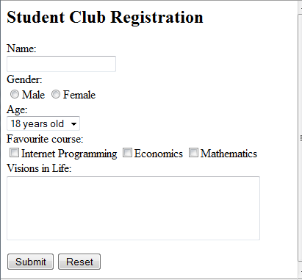
<html>
<head><title>Form</title></head>
<body>
<h2>Student Club Registration</h2>
<form name="form1" method="post" action="register.asp">
Name:<br>
<input type="text" name="myName"><br>
Gender:<br>
<input type="radio" name="myGender" value= "Male">Male
<input type="radio" name="myGender" value= "Female">Female <br>
Age:<br><select name="age">
<option value="18">18 years old</option>
<option value="19">19 years old</option>
<option value="20">20 years old</option>
<option value="21">21 years old</option>
</select><br>
Favourite course:<br>
<input type="checkbox" name="ip">Internet Programming
<input type="checkbox" name="nw">Economics
<input type="checkbox" name="math">Mathematics <br>
Visions in Life: <textarea name="vision" rows="4" cols="40"></textarea><br>
<p><input type="submit" name="submit" value="Submit">
<input type="reset" name="reset" value="Reset"></p></form></body></html>

